Slide 1
Machine Learning-Optimized Pairs Trading Strategy

Slide 2
01
Problem Statement

Slide 3
Problem Statement
Large Quant Firms
Better Infrastructure and Server
Obtain Quick and Fast results using Brute Force Method
Small Firms
Constraints
“How to be more efficient?”
“How can small firms optimize their research process and achieve similar levels of insight with greater efficiency and fewer computational resources?"

Slide 4
Implementing Machine Learning
Bayesian Optimisation
Streamlines and enhances the process of identifying optimal cointegrated pairs using a custom objective function
XGBoost
Predicts future spread values to improve the accuracy of trade signal generation

Slide 5
02
Finding Cointegrated Pairs
Notes:
Summarise the problems faced with the traditional method

Slide 6
Extract Close prices of all Tickers (2019 to 2024)
Why Close Prices > Returns?
Returns are often stationary ; Cointegration needs non-stationary inputs
Directly affects the Quality of Trading Signals
Make the Z Score very tight
Killing our mean reversion edge as there is no long term spread drift to mean revert

Slide 7
Calculating Parameters
5-SMA and 10-SMA (Simple Moving Average)
Avoid selecting pairs that are statistically cointegrated but move in unrelated directions
Strategy prioritises mean reversion ; trend following is extremely important
Volatility
Pairs with High Volatilities making Z-Score signals noisy or unreliable
Pairs with similar volatilities tend to produce cleaner and more stable spreads

Slide 8
Introduction to Bayesian Optimisation

Slide 9
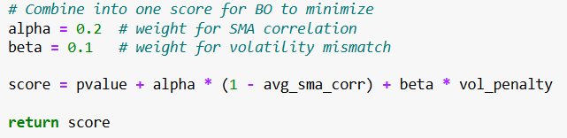
Defining Scoring Function
Higher Weightage on SMA Correlation as compared to Volatility
Promotes a higher emphasis on SMA correlation as compared to Balanced Weightage

Slide 10
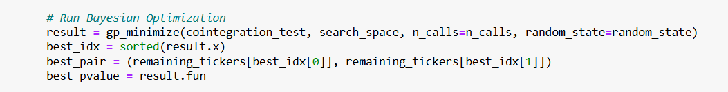
Bayesian Optimisation
A lower score represents a more tradeable pair

Slide 11
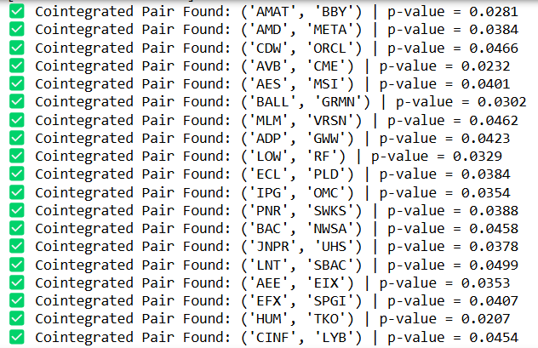
After 3 hours……..

Slide 12
03
Data Preprocessing and Feature Engineering

Slide 13
Feature Engineering
Rolling Window: 30 Days
Category | Feature Name | Description
Statistical Relationship | hedge_ratio | Static beta from OLS regression of Price A on Price B
 | alpha | Intercept term from OLS regression
Spread-Based Features | spread | Price A − β × Price B − α
 | spread_z | Z-score of the spread
 | spread_vol | Rolling standard deviation of spread
 | next_day_spread | Spread value for the next day
Mean Reversion Metrics | halflife | Time for spread to revert halfway to its mean
Technical Indicators | bollinger_pct | Spread’s position within ±2 std Bollinger Bands
Dynamic Risk Measures | rolling_beta | Time-varying beta over a rolling window
 | vol_ratio | Ratio of Price A vs. Price B volatilities
Lead-Lag Relationship | lead_lag_diff | Lagged difference in percentage returns

Slide 14



Data Preprocessing Considerations
Having Sufficient
Data for Training
Validation Dataset Tuning Params
Preventing Data Leakage
Extract yearly
Cointegrated Pairs for training
Ensured Time-period based Train-Validation-Test Splitting
Derive Final Cointegrated Pairs from 1 year before

Slide 15
Data Preprocessing - Train, Val, Test Split
2019
2020
Training Set
2021
2022
2023
Validation Set / Final Training Set
2024
Test Set
(Pairs are derived from 2023)
In total: 100+ Pairs for Training, 17 Pairs for Testing

Slide 16
04
Forecasting Next-day
Pair Spreads (XGBoost)

Slide 17
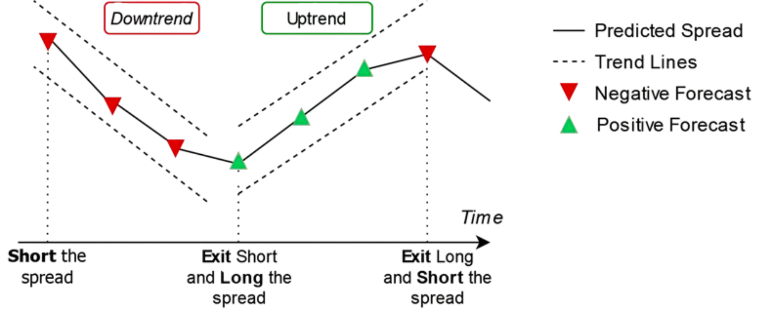
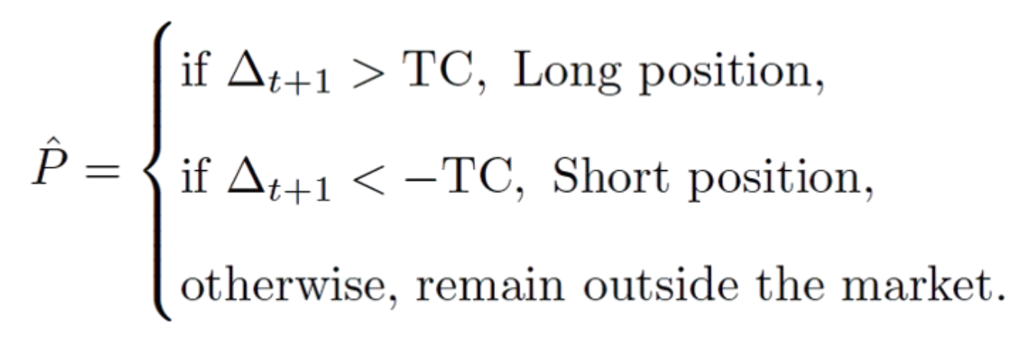
Our Solution
Δ_{t+1}​= ŝ_{t+1​}− s_{t}​, where s represents the spread
Fitting an OLS Model, s_{t}​​ = Price(A​_{(t)})− α −β Price(B​_{(t)})
Trading Strategy Definition
(Figueira & Horta, 2022)
Trading Strategy Idea
(Figueira & Horta, 2022)

Slide 18
Why it works?
Mean Reversion
Predictive Edge
Market Neutral
Pairs trading assumes that the spread between two cointegrated stocks will revert to a long-term mean.
Deviations from this mean create trading opportunities
With a robust spread prediction model, we can anticipate when the pair will converge or diverge and position accordingly.
We bet on the relative price movement of two assets rather than the absolute direction of the market

Slide 19

Why XGBoost?
The XGBoost forecasting model in a Pairs Trading strategy yielded returns of up to 23% p.a. (Figueira & Horta, 2022)
XGBoost demonstrated approximately 60% in-sample data accuracy in classifying profitable trading opportunities. (Jirapongpan & Phumchusri, 2020)
Pairs Trading with Gradient-Boosted Trees generated 46% p.a returns, outperforming deep neural networks (27% p.a) and the general market (9% p.a) (Krauss et al., 2016)

Slide 20
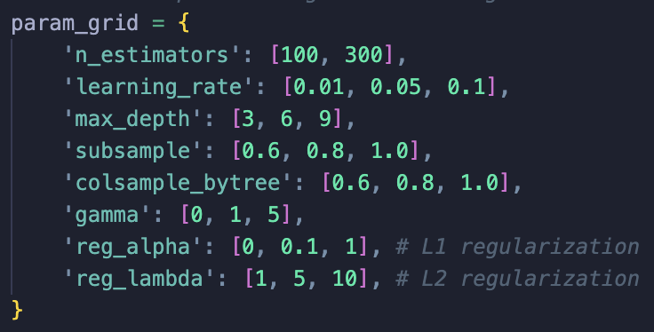
Hyperparameter Tuning
'colsample_bytree': 1.0, 'gamma': 0, 'learning_rate': 0.05, 'max_depth': 3, 'n_estimators': 100, 'reg_alpha': 0, 'reg_lambda': 10, 'subsample': 0.6
4374 Permutations
13122 Total Fits (3 Fold)
40 Minutes of Training Time
GPU Utilisation
GridSearchCV
Best Parameters
Defining the
Parameter Grid

Slide 21
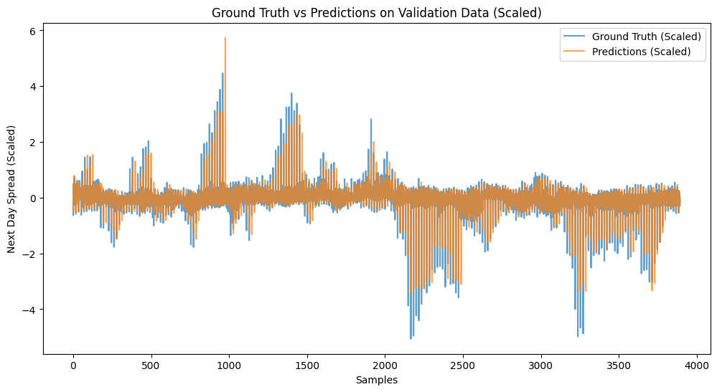
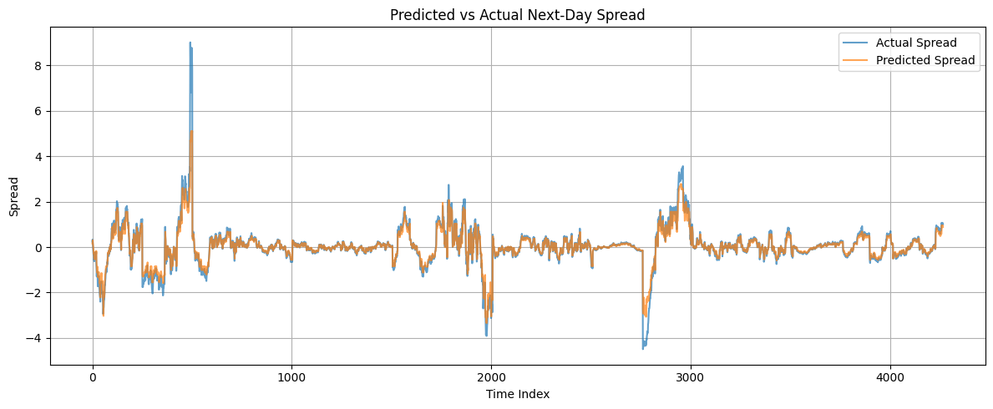
Ground Truth and Predictions Comparison
Validation Set
MSE: 0.0468
Test Set
MSE: 0.0840

Slide 22
05
Results of
ML-Based Pair Trading Strategy

Slide 23
Trading Signal
Predicted spread - Actual spread
Threshold (transaction cost)
Trading Rule:
Long the spread when predicted spread is higher than yesterday’s spread adjusted for transaction cost
Short the spread when predicted spread is lower than yesterday’s spread adjusted for transaction cost

Slide 24
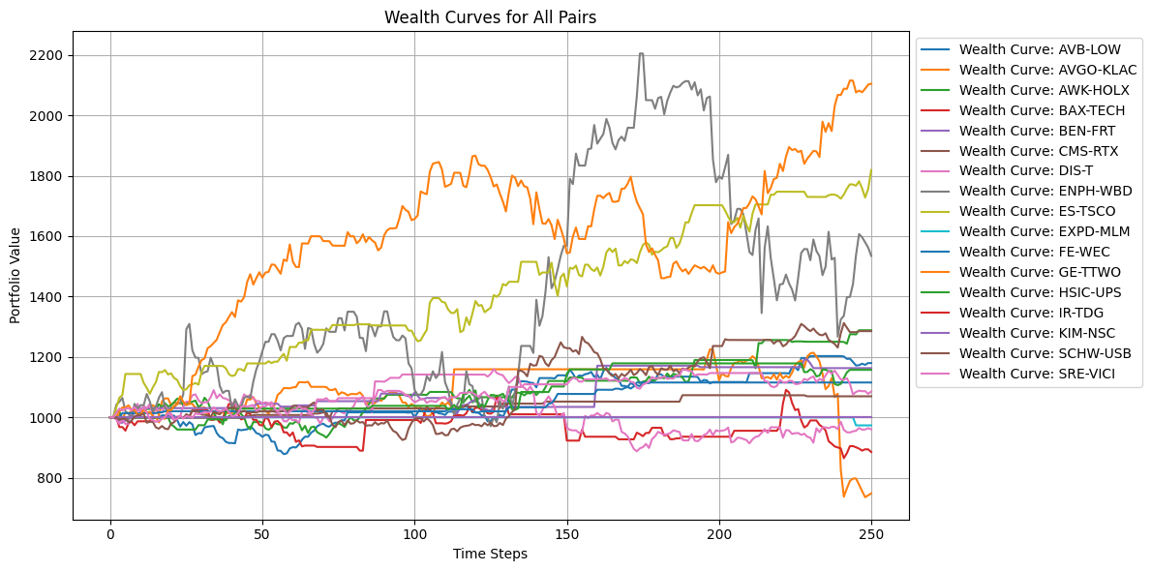
Out of sample performance (2024)
Notes:
Prevented look ahead bias by using 2023 coint pairs and testing strategy performance on 2024 data

Slide 25
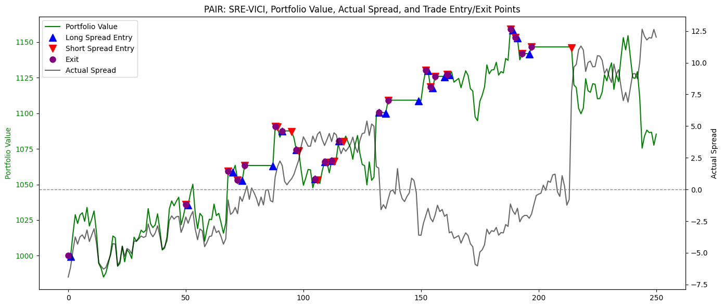
Out of sample performance
Short the spread here but it continued to diverge
Long the spread but it continued to diverge, causing drawdown

Slide 26
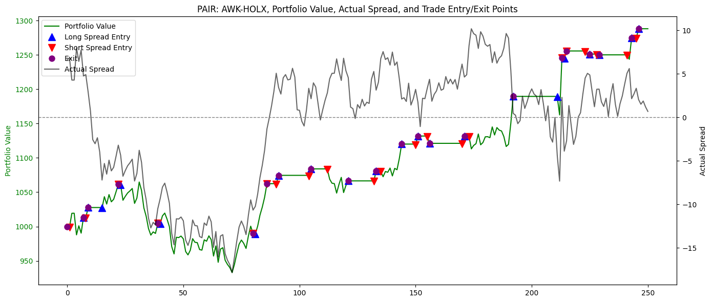
Out of sample performance
Cointegrating relationship temporarily broke down, causing deep draw down
When spreads became stationary again, portfolio value grew steadily with little draw down.

Slide 27
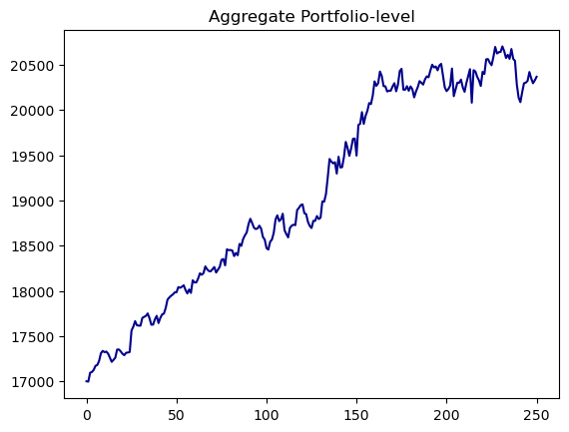
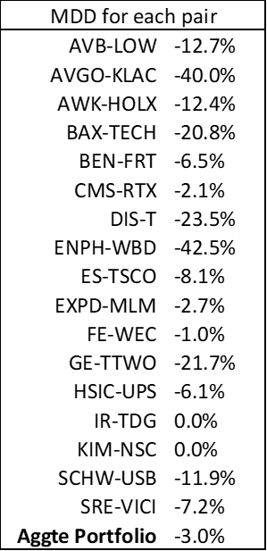
Out of sample performance
Our ML based trading model (like the traditional pair trading approach) performed poorly during periods when the cointegrating relationship broke down, causing higher forecast error.
However, since we diversified across 17 pairs, we managed to reduce portfolio level drawdown.
Returns: 19.81%
Sharpe Ratio: 2.53
MDD: 3%

Slide 28
06
Baseline Trading Strategies
Notes:
Now that we’ve discussed how the machine learning-based pairs trading strategy works, we would like to evaluate how it performs in comparison to several baseline strategies. This comparison helps us understand whether the added complexity of machine learning actually leads to better trading outcomes, or if simpler strategies might be just as effective (next)

Slide 29
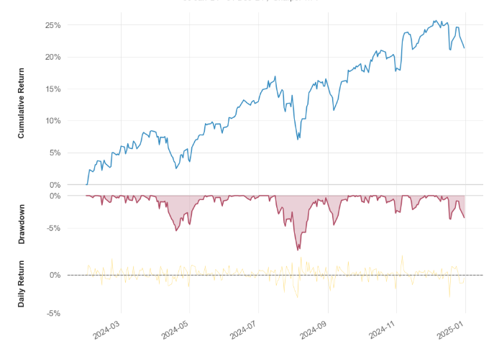
Buy and Hold
Returns: 19.4%
Sharpe: 1.71
Max DD: -8.5%
long-term approach where we buy a stock and hold onto it over a prolonged period
Buy-and-hold often outperforms active strategies after fees, making it a key benchmark.
Short term dips
Overall upwards trend
Yu Yong
Notes:
One of the strategies we use as a benchmark is the buy-and-hold strategy. This is a long-term investment approach where an investor buys a financial asset and holds onto it for an extended period, regardless of short-term market fluctuations. The idea behind this strategy is that, over time, markets generally trend upwards, even though there may be periods of volatility along the way.
This strategy is often used as a baseline because research has shown that many active trading strategies fail to consistently outperform a simple buy-and-hold approach, especially after accounting for fees and taxes. So if a new strategy cannot beat buy and hold in terms of long-term returns or risk-adjusted performance, it is often considered not worth pursuing. (next)
This chart shows the performance of a buy-and-hold strategy for the S&P 500 for 2024. During this period, the portfolio increased in value from approximately $100,000 to about $119,425, representing a total return of 19.4%.
While there were some short-term declines (next) most notably in April and again in late August—the overall trend was upward (next) The maximum drawdown during this time was -8.5%
Finally, the Sharpe ratio was 1.71. This indicates strong risk-adjusted returns, meaning the strategy delivered relatively high returns for the amount of risk taken (next)

Slide 30
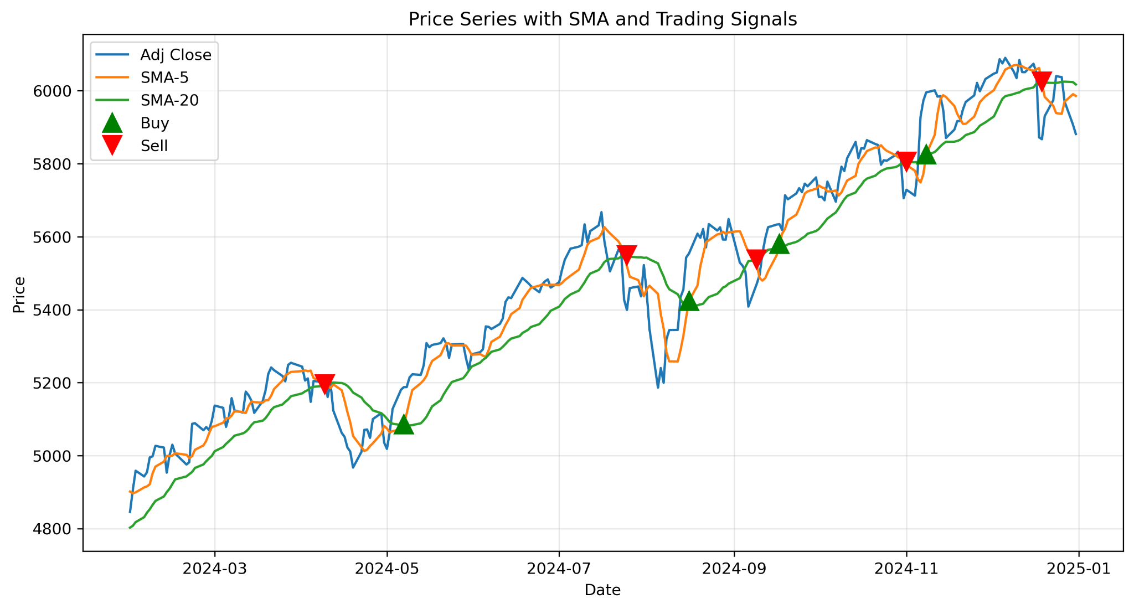
Trend Following
Buy when the short-term average rises above the long-term average and sell when it crosses below.
Reduce risk by exiting or reversing positions during downturns
Notes:
The next strategy we’ll look at is the trend-following strategy.
This approach tries to catch upward or downward trends using indicators like moving averages or momentum. A common example is the moving average crossover—buy when the shorter moving average goes above the longer moving average and sell when it drops below.
Unlike buy and hold, trend-following aims to reduce risk by exiting or reversing positions during downturns. Because of that, it’s often used as a benchmark for more defensive trading strategies.
This (next) graph shows the S&P 500 with its 5-day and 20-day moving averages. We’ve marked the points where the two lines cross, which are used as buy or sell signals in the trend-following strategy

Slide 31
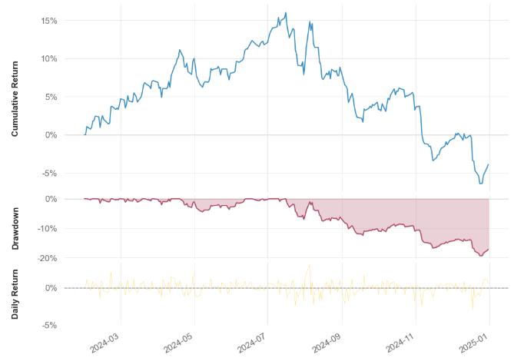
Trend Following
Promising returns in the 1st half
Returns: -2.7%
Sharpe: -0.27
Max DD: -19.3%
Upward trend fails to sustain
Notes:
Here we can see how the trend-following strategy performed in 2024.
Looking at the cumulative return, (next) we see that the strategy did quite well in the first half of the year. By July, it reached a peak return of around 16%. But from August onwards, performance dropped sharply. By the end of the year, most of the gains were lost

Slide 32
07
Comparison of Strategies
Notes:
Now that we've gone through our baseline strategies, let’s compare their performance to see how they stack up against each other (next)

Slide 33
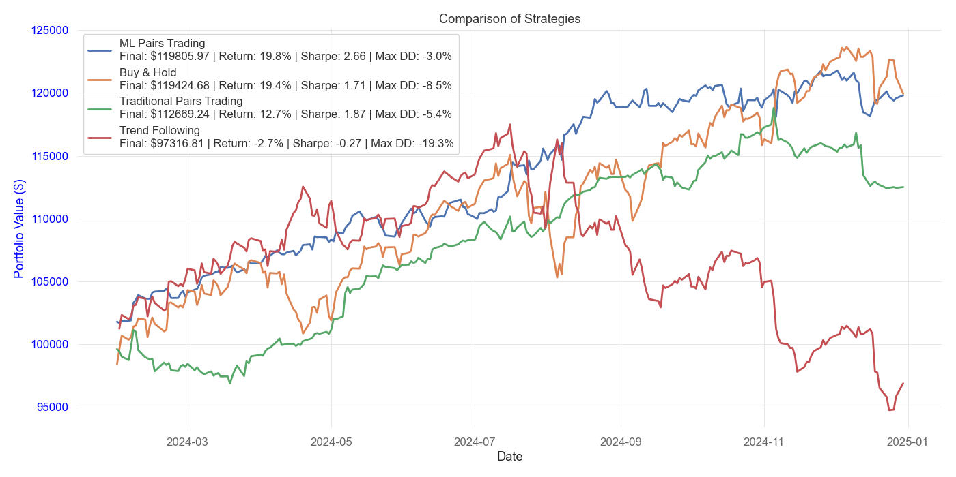
Comparison of Strategies
Top performing: ML based trading model
Similar return as Buy & Hold but with lower volatility and less risk
Notes:
This graph shows a comparison of the investment strategies we have just mentioned over the course of 2024, assessing their performance in terms of their returns, Sharpe ratio, and maximum drawdown. As we can see from the graph, the (next) ML-Based Pair Trading Strategy is the top performing strategy since it (next) offers nearly the same return as Buy & Hold but with lower volatility and less risk.
This suggests that the machine learning strategy not only achieves strong returns, but also manages risk more effectively than the other approaches.

Slide 34
08
Limitations

Slide 35
Limitations
Limitations | Solutions
The strategy is tested on daily prices, not high-frequency intraday data | With access to higher-frequency data, the strategy could potentially be even more effective
Regime shifts can break cointegration → cause pairs to stop being mean-reverting We tested for pairs that were cointegrated over a one-year period, but this increases the risk of unstable pairs | Using multi-year cointegrated pairs would give more reliable results
Notes:
Despite its strong performance, the machine learning-based strategy does come with some limitations.
Firstly, in this project, we used daily data to build and test the model. However, in practice, this type of strategy is often used in high-frequency trading, where it performs better on intraday time frames—such as hourly or even minute-level data. This means that with access to higher-frequency data, the strategy could potentially be even more effective
Another limitation to note is the effect of regime shifts. These are changes in market conditions that can break the cointegration between two assets, meaning their prices no longer move in a mean-reverting way.
In our project, we tested for pairs that were cointegrated over a one-year period. This allowed us to include more pairs, but it also increases the risk of choosing pairs that have high cointegration for a short time.
If more data were available, would be to focus on pairs that remain cointegrated over multiple years which would likely lead to more stable and reliable trading performance (next)

Slide 36
References
Krauss, C., Do, X. A., & Huck, N. (2016). Deep neural networks, gradient-boosted trees, random forests: Statistical arbitrage on the S&P 500. In Friedrich-Alexander University Erlangen-Nuremberg, Institute for Economics, FAU Discussion Papers in Economics (No. 03/2016). Friedrich-Alexander-Universität Erlangen-Nürnberg, Institute for Economics. https://www.econstor.eu/bitstream/10419/130166/1/856307327.pdf?ref=https://githubhelp.com
Jirapongpan, R., & Phumchusri, N. (2020). Prediction of the profitability of pairs trading strategy using machine learning. 2019 IEEE 6th International Conference on Industrial Engineering and Applications (ICIEA), 1025–1030. https://doi.org/10.1109/iciea49774.2020.9102013
Figueira, M., & Horta, N. (2022). Machine Learning-Based Pairs Trading Strategy with Multivariate. SSRN Electronic Journal. https://doi.org/10.2139/ssrn.4295303

